Slide 1
Resiliency and grit
What is it?
Do I have it?
Can I develop it?

Slide 2
What is it?
Resilience is the process and outcome of successfully adapting to difficult or challenging life experiences, especially through mental, emotional, and behavioral flexibility and adjustment to external and internal demands.*
Have you faced a challenge, adversity, and/or major setback recently? How did you handle it?
It’s important to make an effort to learn from previous experiences, take corrective action, and rise to the next challenge.
How do we demonstrate this?
*Source: American Psychological Association, https://www.apa.org/topics/resilience

Slide 3
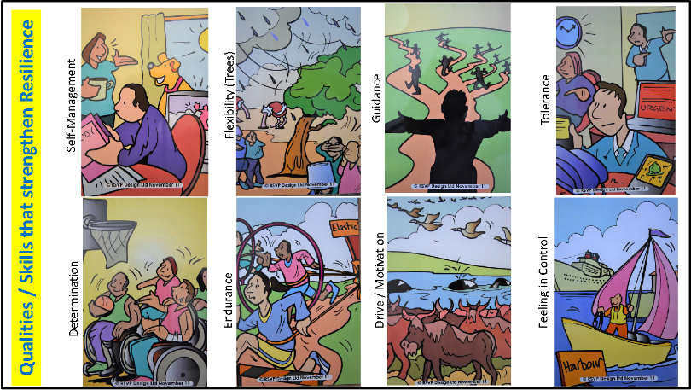
Images of Qualities and Skills that Strengthen Resilience
Notes:
Which traits, qualities and characteristics do you feel you excel in?
Which traits, qualities and characteristics do you feel you would like to develop?

Slide 4
Reflection and discussion…
Which traits, qualities and characteristics do you feel you excel in?
Which traits, qualities and characteristics do you feel you would like to develop?
It’s important to make an effort to learn from previous experiences, take corrective action, and rise to the next challenge.

Slide 5
Do I have resilience? YES
Grit is a life skill that is essential to your success and well-being, now and in your future.
You exhibit grit/resiliency when you are able to face challenges, adversity, disappointments, and major setbacks; learn from the experience; take corrective action; and rise to the next challenge.
Everyone has resiliency. We demonstrate it more often than we realize. Most challenges, setbacks, or disappointments we face are relatively minor. We accept them, learn from them and move on.

